Slide 1
Healthcare in the United States
Name
Institution Affiliation

Slide 2
Healthcare in the US
The United States has the largest economy in the world.
Its healthcare infrastructure has undergone immense changes over the year
According to WHO, the United States spend more money on healthcare than any other country in the world.
  Average cost amounts to about $10000 which
  Over 18% of the country’s GDP.
About 8% higher than the rest of other developed
Notes:
In 2013, 64% of the healthcare cost in the US west government funded through programs like Medicaid, Medicare, veteran health administration the children health insurance program.
Health outcomes:
The U.S. has a higher infant mortality rate and lower life expectancy than comparable countries. (WHO 2007, Commonwealth Fund 2007)
The U.S. has the highest rate of maternal mortality among high-income countries (13 in 100,000), and also the highest rate of C-Sections (32%, as opposed to a WHO recommended 5-15%)
45,000 people die each year simply because they have no health insurance (American Journal of Public Health 2009)
Barriers to care:
Around 50 million people do not have health insurance. Over half of them are African Americans. (Center for American Progress 2009)
Of those who are insured, at least 25 million are underinsured. They often forgo care because of high deductibles and co-pays. (Commonwealth Fund 2008)
700,000 families go bankrupt each year just by trying to pay for their health care –even though three quarters of them are insured. (Health Affairs 2006). In comparison,
the five largest insurance companies made a combined profit of around $12 billion in 2009. (Department of Health and Human Services 2010)
U.S. has fewer doctors and nurses than other high-income countries. (WHO 2007)
Hospitals and doctors are disproportionately located in wealthier areas. Public
hospitals are closing in areas where they are most needed.
The U.S. ranks lowest among high-income countries in its primary care infrastructure.
There is a projected shortage of 44,000 primary care doctors within the next 15 years.(WHO, Health Affairs 2008)
Disparities in access to care:
The U.S. has a highly stratified system with separate tiers for different categories of people receiving different levels of care.
The rights of people of color are violated: e.g., the 10-year survival rate for Black people of people with cancer is 60% for Whites and 48% for African Americans (SEER cancer statistics, also Office of Minority Health).
The quality of care given to people of color is generally lower, including in thetreatment of cancer, heart failure, and pneumonia. (Agency for Healthcare Research and Quality, 2009)
While immigrants are generally healthier than the average citizen upon arrival in the United States, their health tends to deteriorate the longer they remain in the country. (“Unhealthy assimilation", Demography, May 2006)
Women are more likely than men to forgo needed health care due to cost-related access barriers. (Commonwealth Fund 2007)
Women’s right to non-discrimination is violated through increasingly restricting those services only women use, reproductive health care.

Slide 3
Health structure and funding
Healthcare provided by distinct organizations.
Health facilities run and owned mainly by the private sector.
58% of community hospitals In the US are no-profit, 21% profit based and the rest government owned.
Government-funded Medicaid and Medicare account for more expenditure
One in every four dollars of the federal government budget goes to Medicaid and Medicare

Slide 4
Ct
Attempts by US Congress to eliminate the cost sharing of Medicare
Proposed several occasion
Aimed to replace the specific block grants to individual states.
Cost between states and federal government spelled out in the ACA (affordable care act)
Notes:
Medicare in the US currently adheres to the capitalistic model of other industrial sectors in the US. Patients must pay fees for any form of services or goods delivered to them.
This fee for service approach has made the medical professionals order for more test and treatment that are usually completely unnecessary.

Slide 5
Health Care development
The American health care system highly tech developed.
The medical-legal environment in the US is similarly highly liberalized.
The major subsystems of the US healthcare system included
  The managed care
  Military
  Subsystem for vulnerable populations
Notes:
The technological advancement has however served to reduce physical to patient interaction as doctor base most of their diagnostic diagnosis on laboratory and radiological studies.
Due to the high literacy level, patients are more aware of their right and thus frequently sue physicians for even minor errors in the provision of care. They have an implication where doctors order very many unnecessary tests just to cover themselves include malpractice case arises. This has served to increase the cost of health care immensely.
The passage of the Affordable Care Act also referred to as the Obama Care Act in 2010 overhauled that US health system. It for the first time enabled the poor in the American society to access quality care they previously could not due to lack of health insurance. Apart from these, it offers patients a great degree of protection in the healthcare environment.
The US does not have a universal healthcare delivery system. Market forces have however developed subsystems to take care of the need of specific proportions of the population.

Slide 6
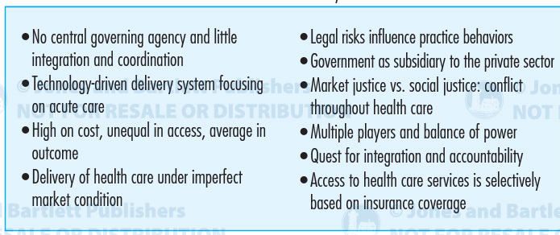
The US Healthcare System’s Main Characteristics

Slide 7
References
Miller, E., McCaw, B., Humphreys, B. L., & Mitchell, C. (2015). Integrating intimate partner violence assessment and intervention into healthcare in the United States: A systems approach. Journal of Women's Health, 24(1), 92-99.
Vallabhaneni, S., Sapiano, M., Weiner, L., Lockhart, S., & Magill, S. S. (2016, December). Antifungal Susceptibility Testing Practices at Acute Care Hospitals Enrolled in the National Healthcare Safety Network, United States, 2011─ 2015. In Open Forum Infectious Diseases (Vol. 3, No. suppl_1). Oxford University Press.
Watson, M., Benard, V., & Flagg, E. W. (2018). Assessment of trends in cervical cancer screening rates using healthcare claims data: United States, 2003–2014. Preventive medicine reports, 9, 124-130.

